Slide 1

Computer Science and Engineering
Discipline Discourse
Jesus Gonzalez
Kelvin Lam
Rolly Padua
Majok Ring
Huimin Zhang

Slide 2
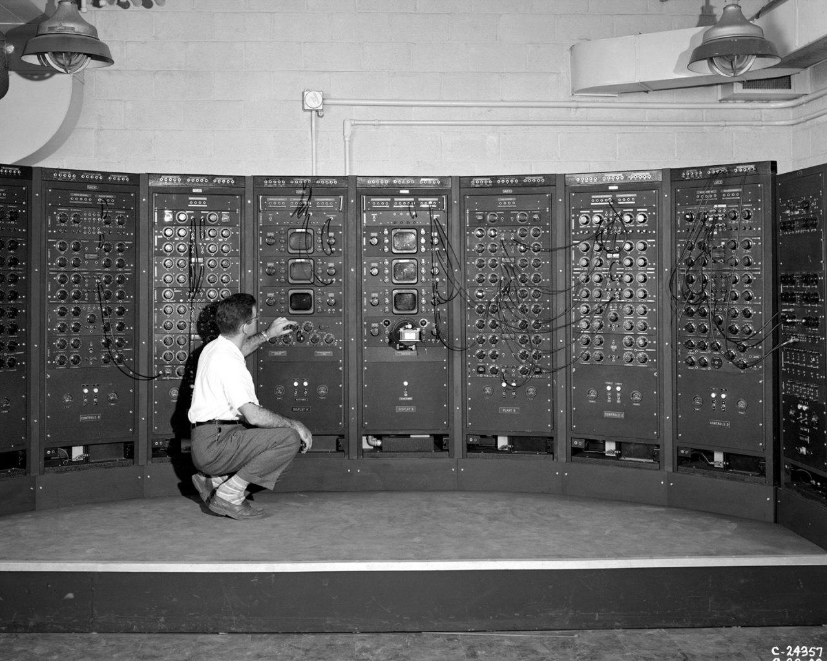
History

Slide 3
History
•
New Major
Computers gain traction in 1940s
Konrad Zuse develops first functional program controlled computer
•Keynote: Increased dependence on research subsidies as per the cost of materials.
•Key Values: Curiosity/theory: Research more oriented in theoretics

Slide 4
“The Descriptivist revolution takes a little time to unpack, but it's worth it.”
-David Foster Wallace

Slide 5
MapReduce: Simplified
Data Processing on
Large Clusters
Authored by Jeffrey Dean, Sanjay Ghemawat
Published by Google

Slide 6
Cited over 16,000 times

Slide 7
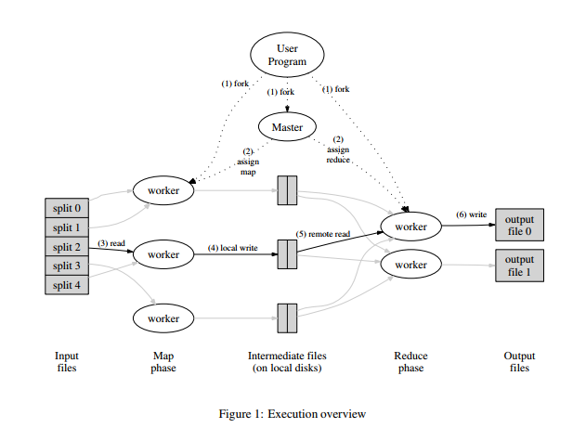
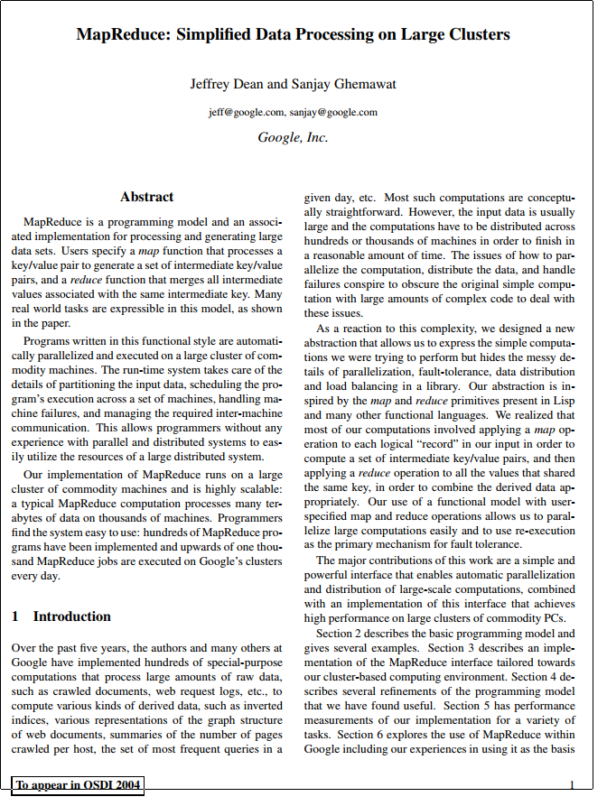
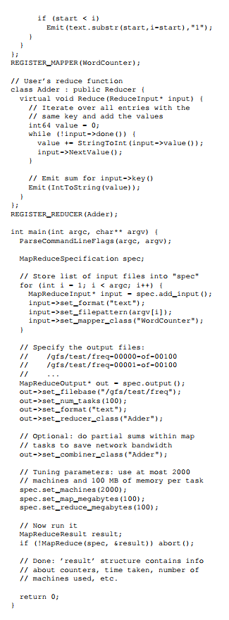
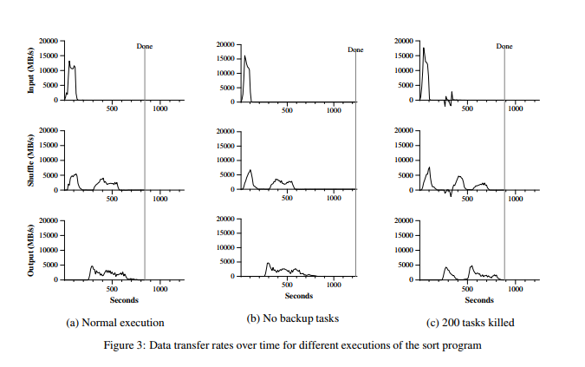
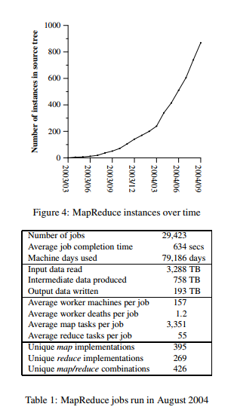

Slide 8
State considered harmful
A proposal for a stateless laptop
by Joanna Rutkowska

Slide 9
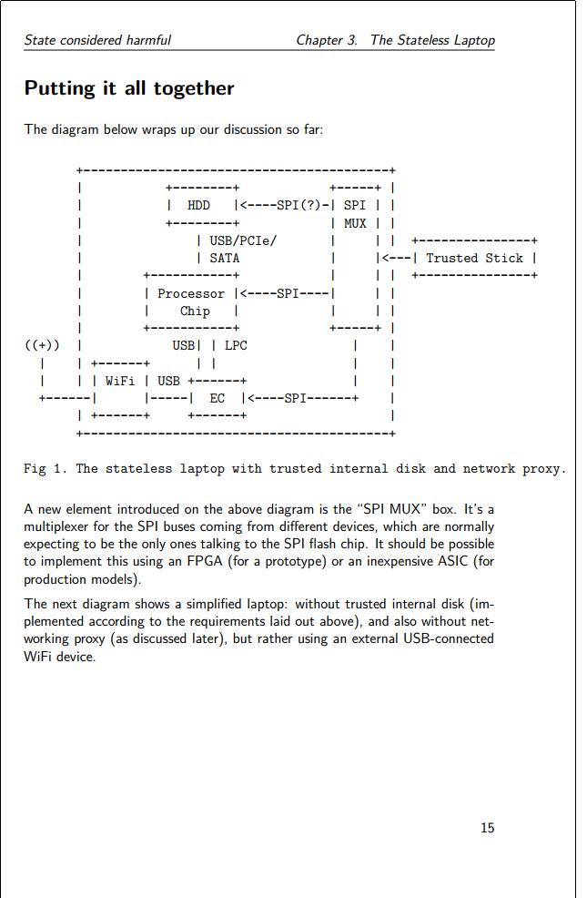
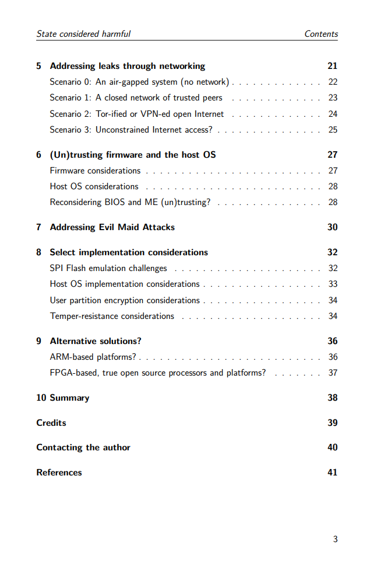

Slide 10
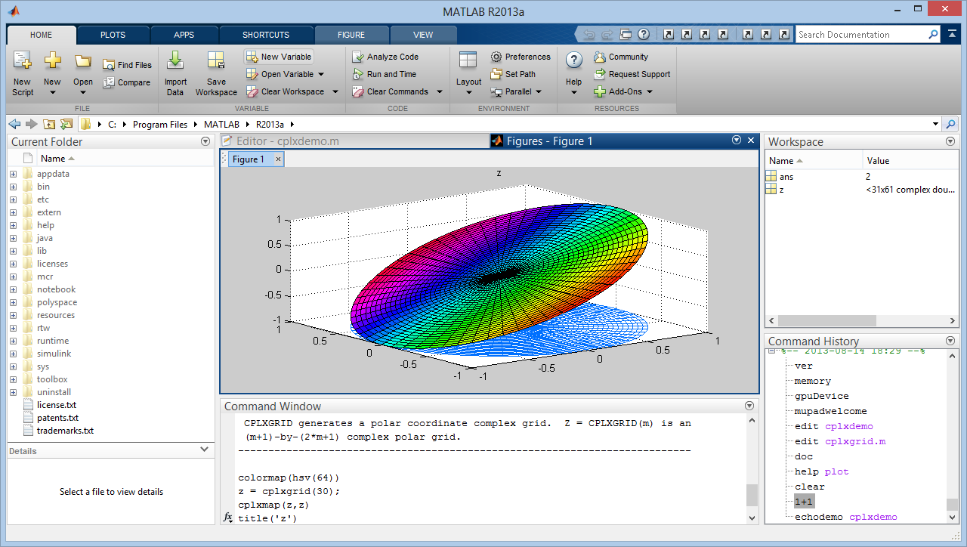
Interdiscipline: MatTrack
A MATLAB-Based Quantitative Image Analysis Platform for Investigating Real-Time Photo-Converted Fluorescent Signals in Live Cells.

Slide 11
-Program MATLAB-based computational platform which allows image collection and analysis of live cell fluorescent microscopy.
-Generates maps and visualizes protein trafficking patterns and regions of accumulation.
•Key point: in order to advance research In other fields such as the natural sciences, heavy computation is needed.

Slide 12
Key point: in order to advance research In other fields such as the natural sciences, heavy computation is needed.

Slide 13
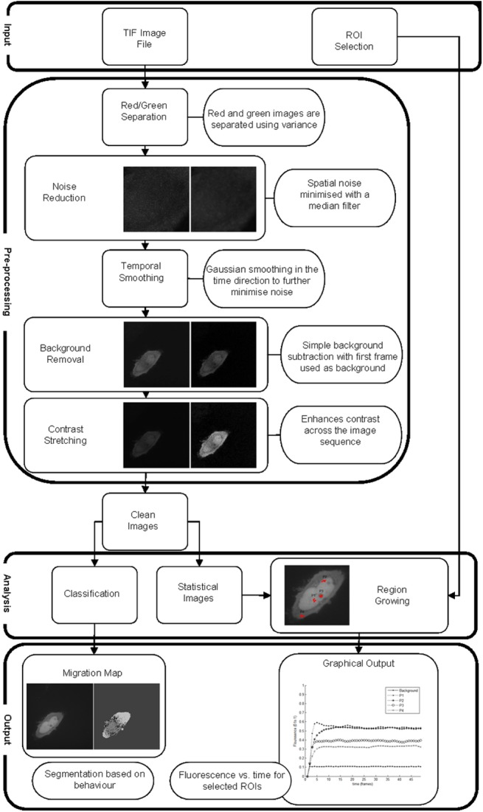
<3 you

Slide 14

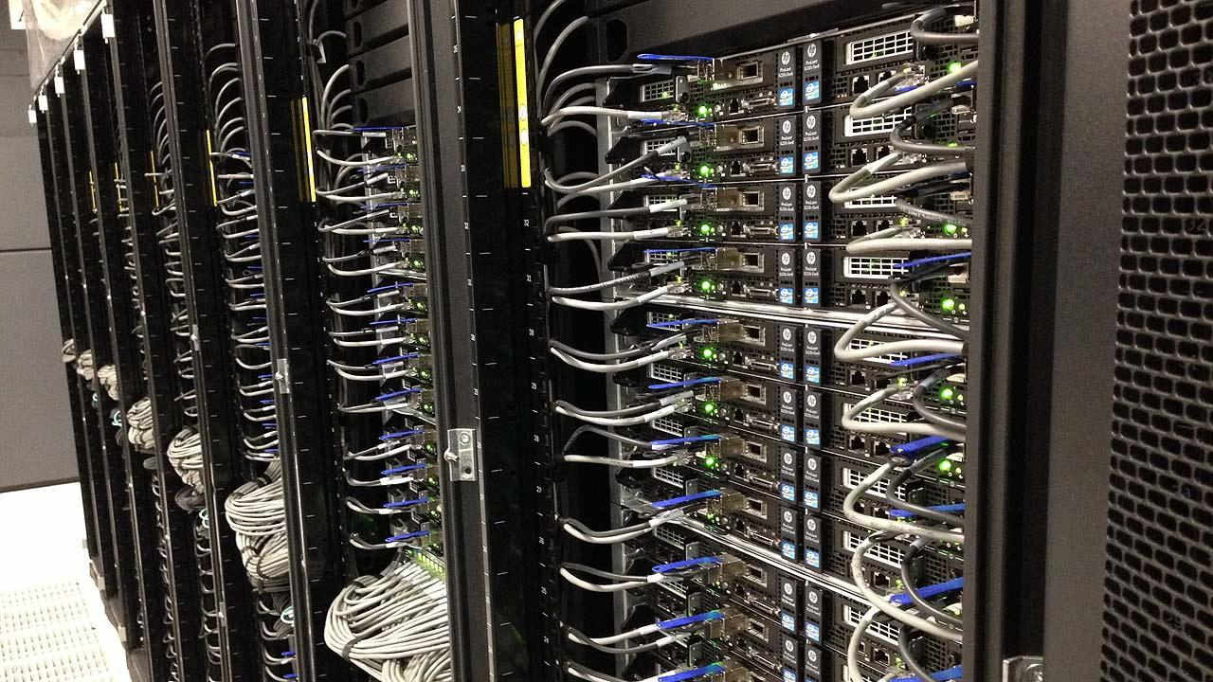
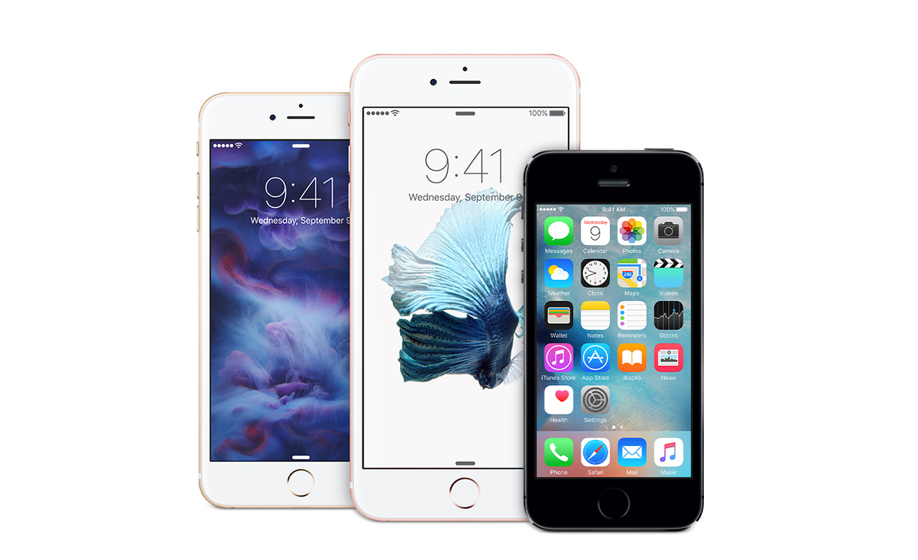

Usability and Efficiency
Portable
Daily essential
World wide
Easily accessible
Precise measurements
Fast process speed
Big Memory

Slide 15

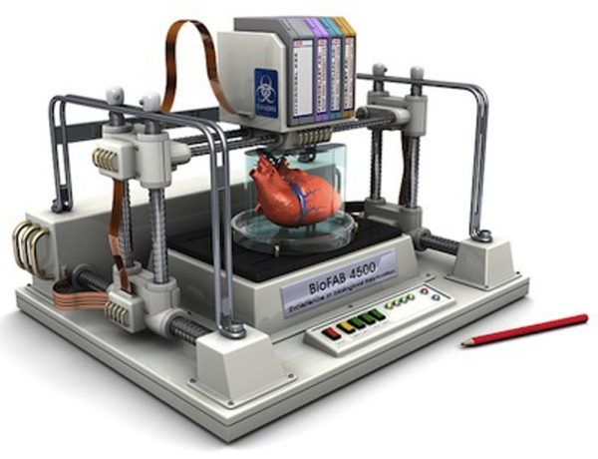
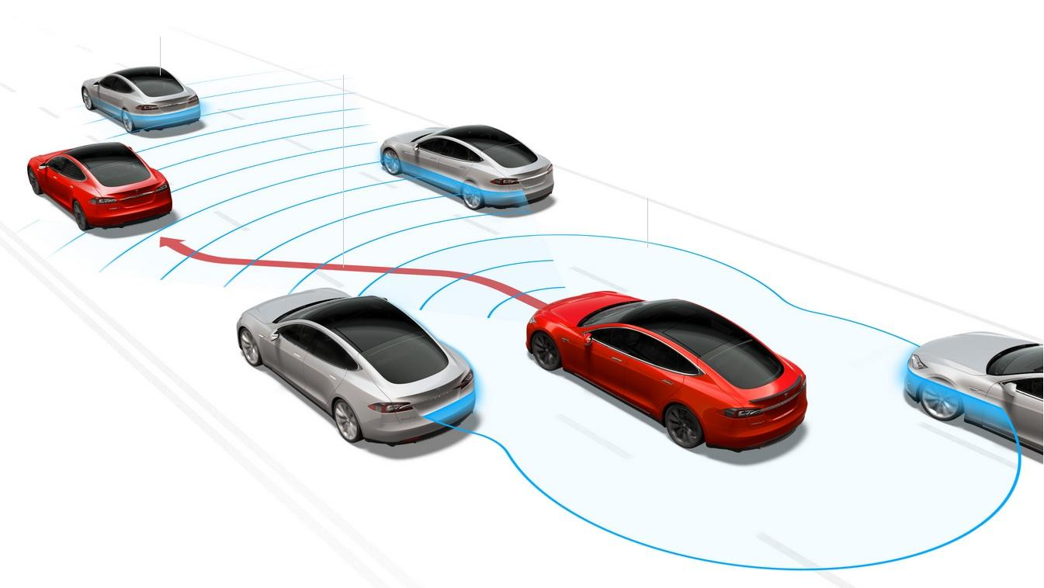
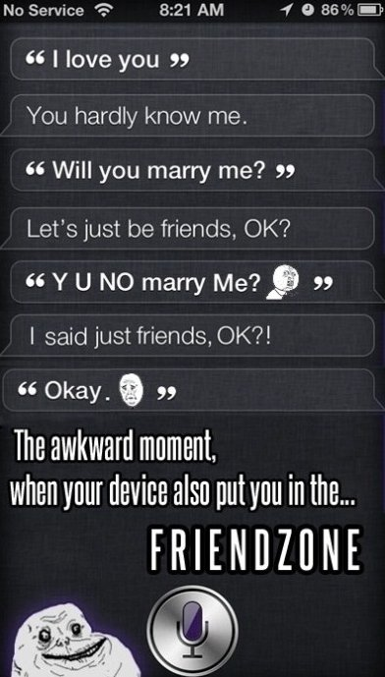
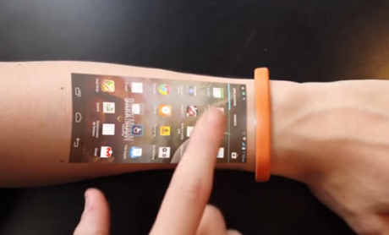
Innovations
Artificial intelligence
Wearable Technology
Virtual reality
Cloud Computing
Operating Systems
Robotics
Drones
3-D printing
Self-driving car
Sensors

Slide 16

Information Dispersal
Notes:
Most fields of study require any respectable research article to be published in a research journal. In computer science, most respectable publications are not found in research journals, but in conference style publications.

Slide 17

Information Dispersal
Technical in nature, and therefore hard to follow along in unless well versed in the protocols revolving the research.

Slide 18

Conference Publications
Notes:
Publications through research conferences are rooted from the conception of computer science. Schools and research institutions had to hold conferences where researchers would present their ideas to eachother inorder for the researchers to get feedback from the community, since senior computer scientists did not exist this early on in the field of study.

Slide 19
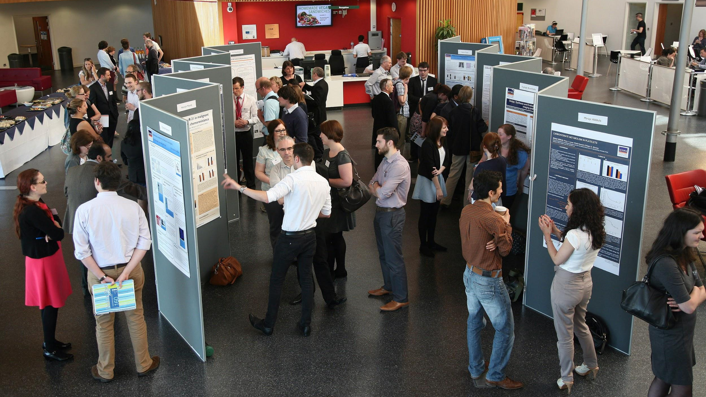
Notes:
To date, conference publications are still favored over journal publications. While it has just been a result of tradition, scientists argue that the field needs a transition away from conference publications and into journal publications because of the benefits from the peer review process. Although the benefits of publishing in journals are great, the culture of computer science will likely take a while before changing to more journal based publications.

Slide 20
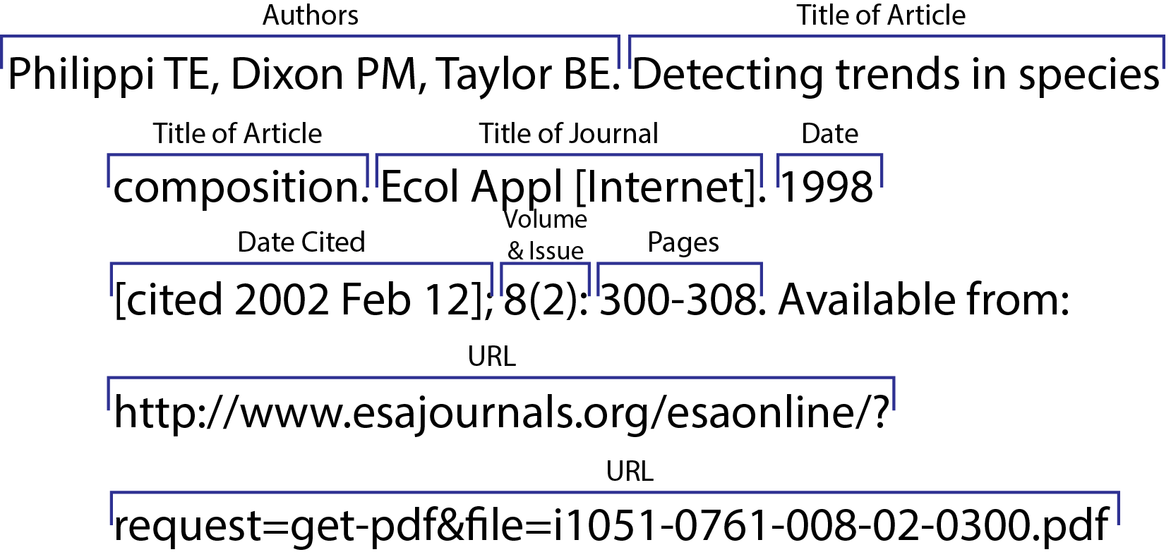
Citation Methods

Slide 21
Citation Methods
Citation-Sequence
Name-year
Citation-Name
Association of Computing Machinery (ACM)
No prefered method.
Notes:
Citation Sequence - Citations appear in the End Reference in the order they appeared in the text.
Name-Year - Citations appear by the year, beginning with the earliest source. If more than two sources are of the same year, then they would be ordered by alphabetical order.
Citation-Name - All sources are organized by alphabetical order regardless of everything else.
ACM - Specific format in which the sources are sorted by the authors last name in alphabetical order.
The URL is likely to be put in this section because of various reasons (explain it!)
~GROUP! If you feel like you need to change anything, go ahead and do so (Delete this line)

